Slide 1

Database Management System (CS232) BS(SE,CySec) gg
Week 04
Said Nabi
said.nabi@giki.edu.pk
Faculty of Computer Science and engineering
Gik Institute Topi, Swabi

Slide 2
Relationships
Relationship types and Instances
Constraints on Relationship Types
Attributes of Relationship Types
Relationship Representation in ER Diagram
Degree Relationships
Examples

Slide 3
Relationships
Associations between instances of one or more entity types
Given a name that describes its function.
relationship name is an active or a passive verb.
Relationship name: writes
Author
Book
An author writes one or more books A book can be written by one or more authors.

Slide 4
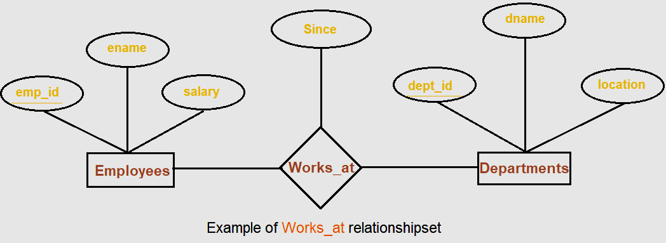
Example

Slide 5
Relationship Types and Instances…
Informally, a relationship type is a meaningful association among entity types.
A relationship (instance) is an association of entities where the association includes one entity from each participating entity type.

Slide 6
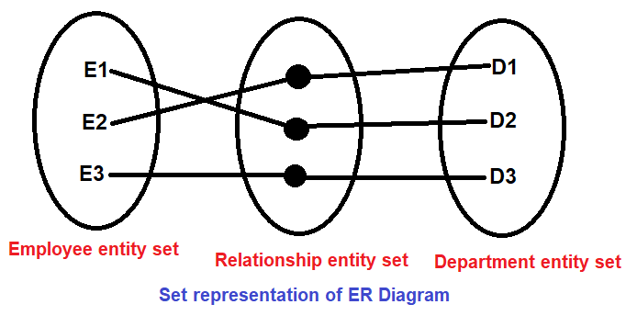
Relationship Set
A set of relationships of similar type is called a relationship set.

Slide 7
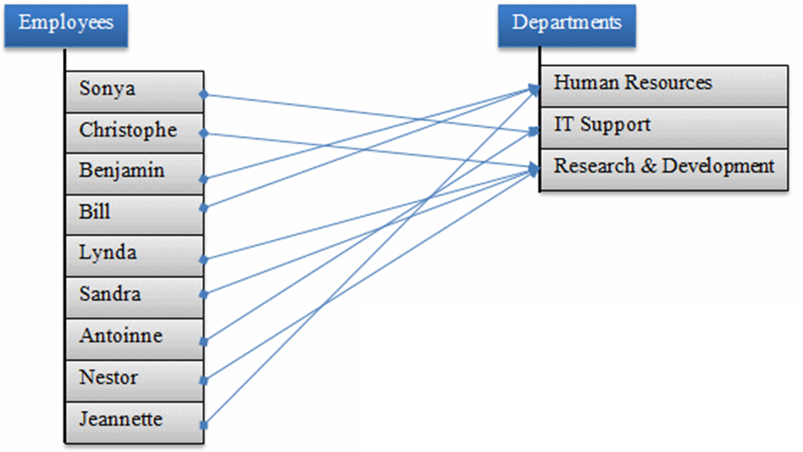
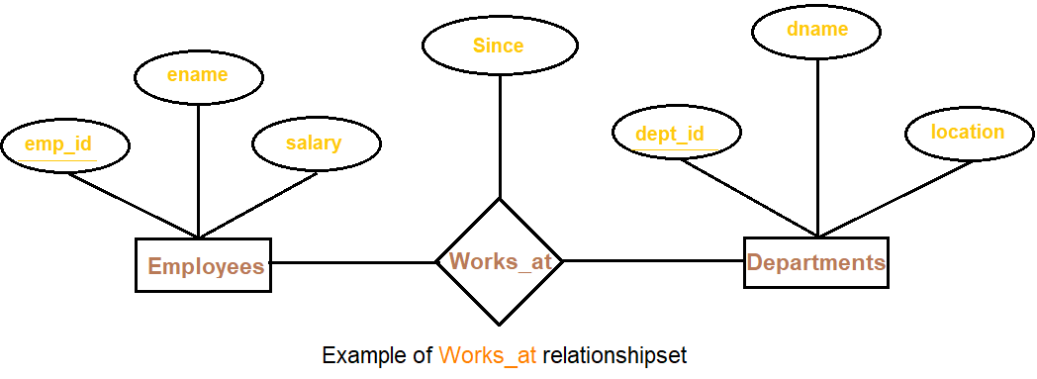
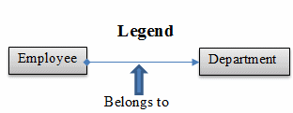
Relationship Instances…

Slide 8
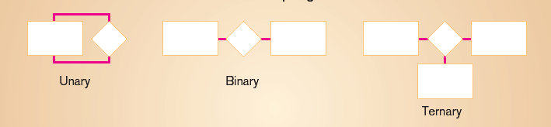
Degree of Relationships
Degree: number of entity types that participate in a relationship
Three cases
Unary: between two instances of one entity type
Binary: between the instances of two entity types
Ternary: among the instances of three entity types

Slide 9
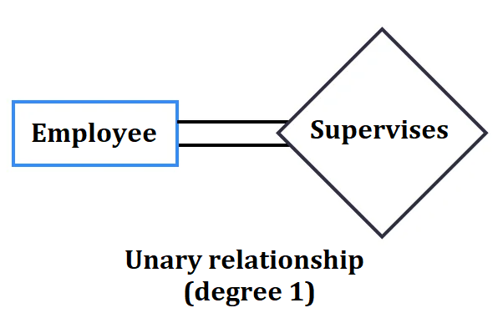
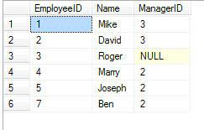
Unary relationship
When there is a relationship between two entities of the same type is known as Unary relationship.
It is known as a recursive relationship.
This means that the relationship is between different instances of the same entity type.
For example: An employee can supervise group of employees. Hence, this is a recursive relationship of entity employee with itself.

Slide 10
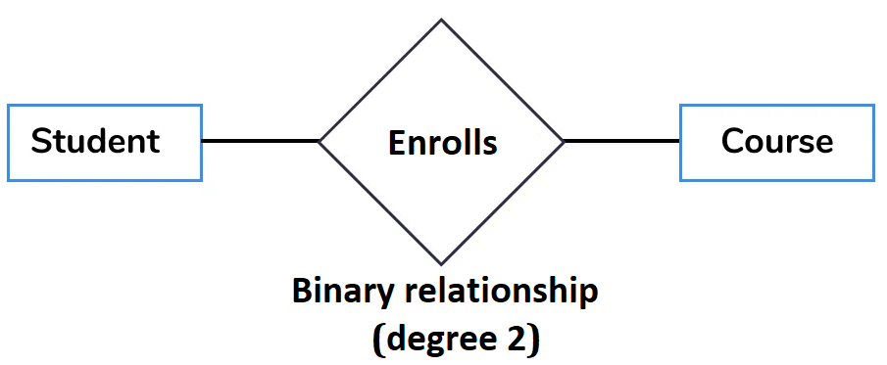
Binary Relationship
When there are exactly two entity sets participating in a relationship then such type of relationship is called binary relationship.
For example, a student enrolls a course, Here, “enrolls” is a relationship and this is the relationship between a Student entity and a Course entity.

Slide 11
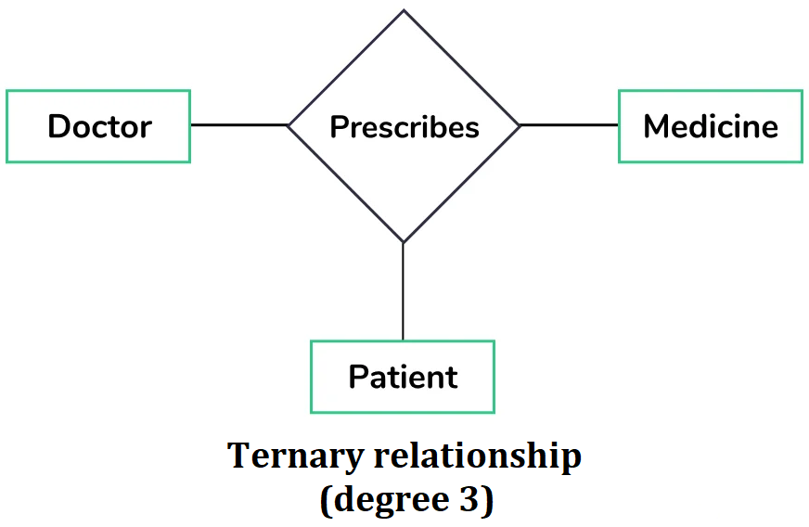
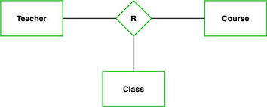
Ternary relationship
When there are exactly three entity sets participating in a relationship then such type of relationship is called ternary relationship
For example: In the real world, a patient goes to a doctor and doctor prescribes the medicine to the patient, three entities Doctor, patient and medicine are involved in the relationship “prescribes”.

Slide 12
Mapping Cardinalities / Constraints
mapping constraint defines how many entities can be related to another entity to a relationship.
It is most useful in describing the relationship sets that involve more than two entity sets.
For binary relationship set R on an entity set A and B, there are four possible.
These are as follows:
One to one (1:1)
One to many (1:M)
Many to one (M:1)
Many to many (M:M)

Slide 13
Notations
Chen Model
1 to represent one.
M to represent many
Crow’s Foot
1
M
One
many
One or many
Mandatory one , means (1,1)

Slide 14
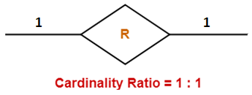
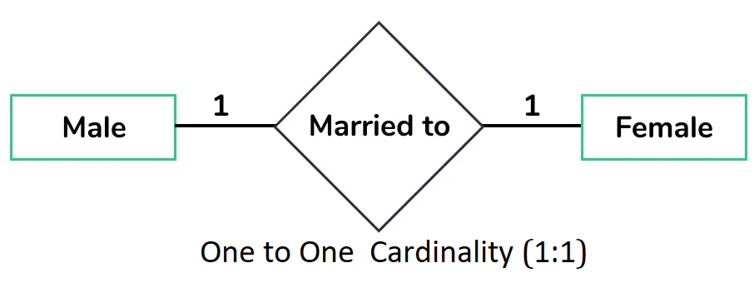
One to One (1:1)
An entity in A is associated with at most one entity in B, and an entity in B is associated with at most one entity in A.
It’s a relationship where a record in one entity (table) is associated with exactly one record in another entity (table).
For example, Assume that only one male can be married to only one female and one female can be married to only one male, this can be viewed as one to one cardinality

Slide 15
One-to-One Relationships
One family lives in one house, and the house contains one family.
One person has one passport, and the passport can only be used by one person.
A person owns one dog, and the dog is owned by one person.
One person owns one car, and the car is owned by one person.
For many websites, one email address is associated with exactly one user account and each user account is identified by its email address.
Each person has a unique set of fingerprints.

Slide 16
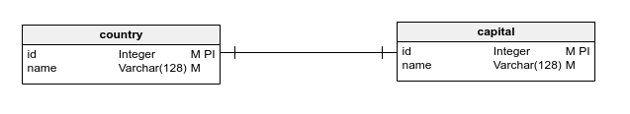
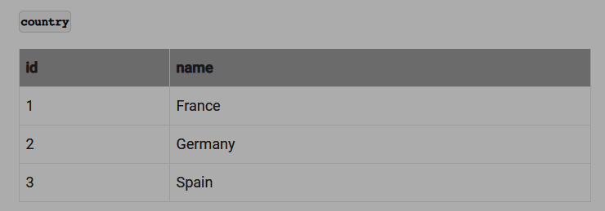
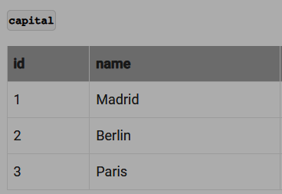
1
has
1
In a one-to-one relationship the foreign key may be placed in either of the entities.

Slide 17
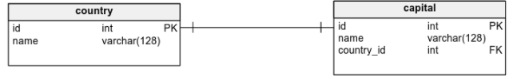
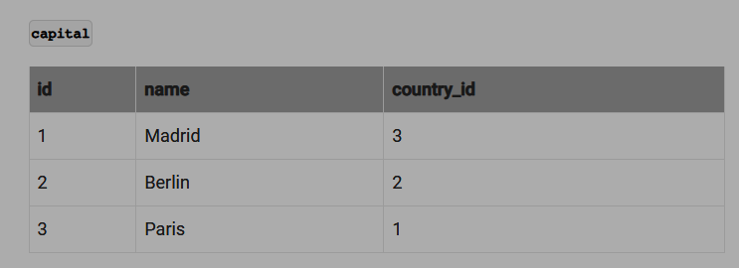
In a one-to-one relationship the foreign key may be placed in either of the entities.

Slide 18
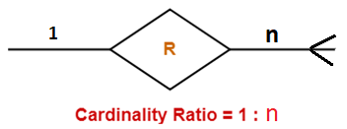
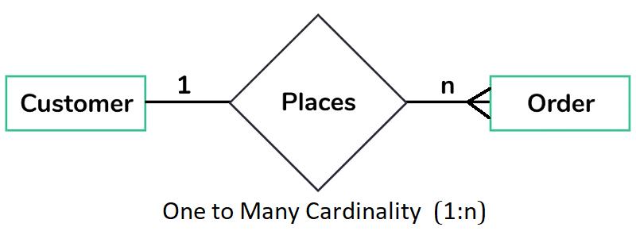
One to Many (1 : M)
An entity in A is associated with any (zero or more) entities of B, and an entity in B can be associated with at most one entity in A.
Should be the norm in any relational database design
For example, a customer can place multiple orders from a website/shop.
Symbol used

Slide 19
One-to-Many Relationships
A car maker makes many different models, but a particular car model is built only by a single car maker.
One customer may make several purchases, but each purchase is made by a single customer.
One company can have many phone numbers, but a phone number belongs to one company.

Slide 20
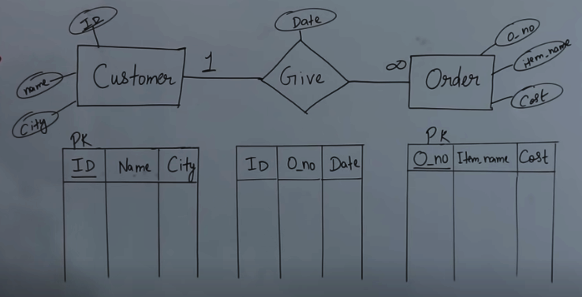
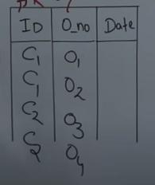
A customer can place multiple orders
Particular order is given by a customer
Notes:
Primary Key
Reduce Tables

Slide 21
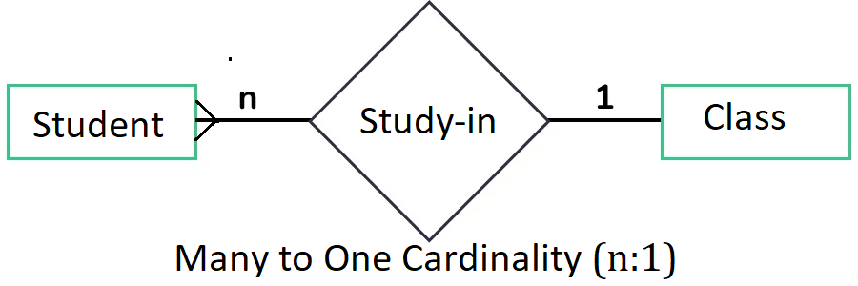
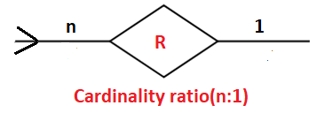
Many to One (M: 1)
An entity in A is associated with at most one entity in B. and an entity in B can be associated with any (zero or more) number of entities in A.
For example: A student can belong to at most one degree program but one program can have many students.
Symbol used

Slide 22
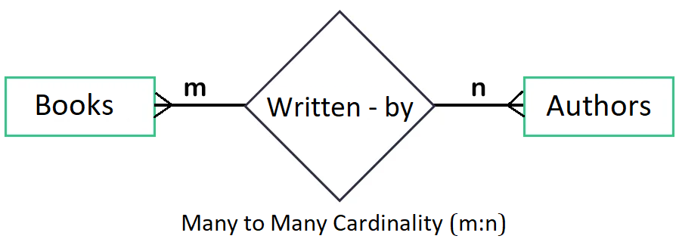
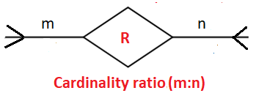
Many to Many (M : N)
An entity in A is associated with any number of entities in B and an entity in B is associated with any number of entities in A.
For example: A book is written by many authors and an author can write many books.
Symbol used

Slide 23
Student
Study
Course
M
N
RollNo | Name | Age
Code | Name | hours
RollNo | Code

Slide 24
Student
Study
Course
M
N
RollNo | Name | Age
R1 | Ali | 20
R2 | Ahmed | 21
R3 | Fatima | 22
R4 | Sara | 21
Code | Name | hours
C1 | SE | 4
C2 | OOP | 4
C3 | DB | 4
C4 | AI | 4
RollNo | Code

Slide 25
Student
Study
Course
M
N
RollNo | Name | Age
R1 | Ali | 20
R2 | Ahmed | 21
R3 | Fatima | 22
R4 | Sara | 21
Code | Name | hours
C1 | SE | 4
C2 | OOP | 4
C3 | DB | 4
C4 | AI | 4
1
1
RollNo | Code
R1 | C1
R2 | C2
R2 | C1
R3 | C1
R4 | C3
R1 | C3
R3 | C2
M
M
Three tables will form for many to many relationship

Slide 26
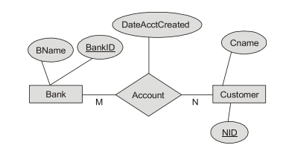

How many tables are required?

Slide 27
M:N relationships
Must be avoided because they lead to data redundancies.
Can be implemented by breaking it up to produce a set of 1:M relationships
Can avoid problems inherent to M:N relationship by creating a composite entity or bridge entity
RollNo | Name | Age
R1 | Ali | 20
R2 | Ahmed | 21
R3 | Fatima | 22
R4 | Sara | 21
Code | Name | hours
C1 | SE | 4
C2 | OOP | 4
C3 | DB | 4
C4 | AI | 4
1
1
RollNo | Code
R1 | C1
R2 | C2
R2 | C1
R3 | C1
R4 | C3
R1 | C3
R3 | C2
M
M

Slide 28
Constraints on relationships
Cardinality Ratio (Maximum Cardinality)
1:1
1:M
M:1
M:M
Participation (Minimum Cardinality)
Now, we look into this

Slide 29
Participation Constraints
There are two types of participation constraints—total and partial.
Total Participation
The participation of an entity set E in a relationship set R is said to be total if every entity in E participates in at least one relationship in R.
Double line indicates the total participation constraint.
Partial Participation
If only some entities in E participate in relationships in R, the participation of entity set E in relationship R is said to be partial.
Single line indicates the partial participation constraint.
Notes:
Which entity has mandatory participation? Applied on Entities

Slide 30


Example
Employee
License
has
L
L
L
If there is an employee, it is not necessarily true that he must has license [may or may not have]
If there is license, there must be an employee corresponding to that

Slide 31
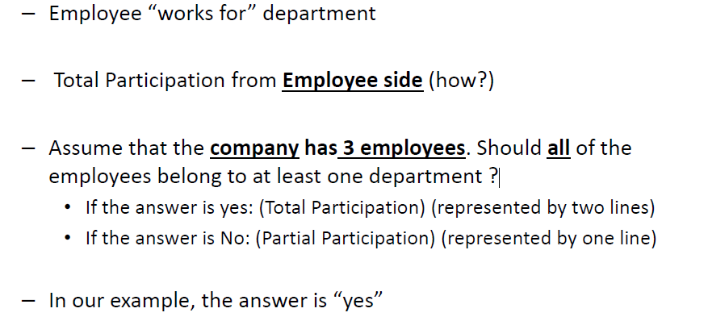
Example-2
Employee
Department
Works for

Slide 32
Example
Cardinality Constraints : At most. (1-N)
Participation Constraints : At least or Minimum. (0/1) [optional/Mandatory]
Employee
Department
Manages
Notes:
Mandatory participation

Slide 33
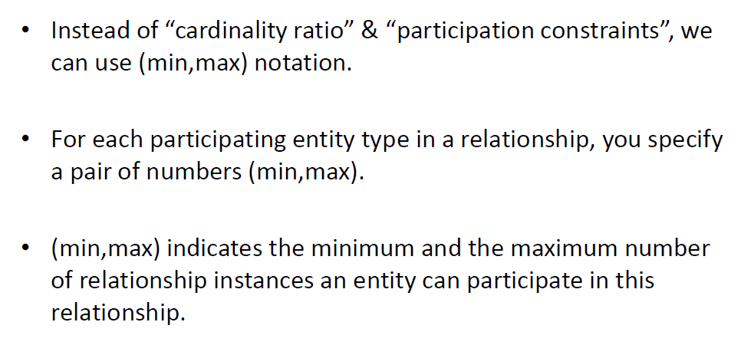
(Min, Max) Notations for Structural Constraints

Slide 34
(Min, Max) Notations example
Professor
teaches
Class
Professor
teaches
Class
(1,4)
(1,1)
(1,1)
(1,4)
Cardinality
Cardinality
Maximum Cardinality: Maximum number of times an entity participating in a relationship
Minimum Cardinality: Minimum number of times an entity participating in a relationship

Slide 35

Any Questions??

